Slide 1
Vulnerability Report on zero.webappsecurity.com

Slide 2
Summary
While Performing Automated Vulnerability Scanning I found that zero.webappsecurity.com website has Out-of-date Version Open SSL Vulnerability.
The certainity of Out-of-date Version Open SSL Vulnerability is Critical.
It Consists of Vulnerabilities like OpenSSL Cryptographic Issues Vulnerability, OpenSSL Improper Authentication Vulnerability, OpenSSL Resource Management Errors Vulnerability…etc.

Slide 3
Description
Domain : zero.webappsecurity.com
Vulnerability : Out-of-date Version (OpenSSL)
Certainty | : Critical
URL | : https://zero.webappsecurity.com/
Identified Version | : 0.9.8e
Latest Version | : 3.0.6 (in this branch)
Vulnerability Database | : Result is based on 10/14/2022 20:30:00 vulnerability database content.

Slide 4
Testing Environment
OS Version : Windows 11
Testing Tools Used : Net Sparker v5.8
Scan Policy : AIIOS (AllWebServer-AllAppServer Microsoft SQL Server-MYSQL-Oracle-PostgreSQL-Other)

Slide 5
Steps to Reproduce
To reproduce this, an attacker has to:
Firstly, Open Net Sparker
Enter Target Website URL
Change the Scan Policy to AIIOS (AllWebServer- AllAppServer-Microsoft SQL Server-MYSQL-Oracle-PostgreSQL-Other)
Click on Start Scan

Slide 6
Impact
Since this is an old version of the software, it may be vulnerable to attacks.
Known Vulnerabilities in this Version
OpenSSL Cryptographic Issues Vulnerability
OpenSSL before 0.9.8j, when SSL_OP_NETSCAPE_REUSE_CIPHER_CHANGE_BUG is enabled, does not prevent modification of the ciphersuite in the session cache, which allows remote attackers to force the use of a disabled cipher.
OpenSSL Improper Authentication Vulnerability
OpenSSL before 1.0.0c, when J-PAKE is enabled, does not properly validate the public parameters in the J-PAKE protocol which allows remote attackers to bypass the need for knowledge of the shared secret.

Slide 7
OpenSSL Resource Management Errors Vulnerability
Double free vulnerability in OpenSSL 0.9.8 before 0.9.8s, when X509_V_FLAG_POLICY_CHECK is enabled.
OpenSSL Improper Input Validation Vulnerability
The kssl_keytab_is_available function in ssl/kssl.c in OpenSSL before 0.9.8n, when Kerberos is enabled but Kerberos configuration files cannot be opened, does not check a certain return value.
OpenSSL Improper Restriction of Operations within the Bounds of a Memory Buffer Vulnerability
The dtls1_buffer_record function in ssl/d1_pkt.c in OpenSSL 0.9.8k and earlier 0.9.8 versions allows remote attackers to cause a denial of service.

Slide 8
OpenSSL Numeric Errors Vulnerability
OpenSSL before 0.9.8k on WIN64 and certain other platforms does not properly handle a malformed ASN.1 structure, which allows remote attackers to cause a denial of service.
OpenSSL Improper Input Validation Vulnerability
OpenSSL 0.9.8i and earlier does not properly check the return value from the EVP_VerifyFinal function, which allows remote attackers to bypass validation.
OpenSSL Permissions, Privileges, and Access Controls Vulnerability
OpenSSL before 0.9.8l, and 0.9.8m through 1.x, does not properly restrict client-initiated renegotiation within the SSL and TLS protocols, which might make it easier for remote attackers to cause a denial of service.

Slide 9
OpenSSL Concurrent Execution using Shared Resource with Improper Synchronization Vulnerability
Race condition in the ssl3_read_bytes function in s3_pkt.c in OpenSSL through 1.0.1g, when SSL_MODE_RELEASE_BUFFERS is enabled, allows remote attackers to inject data across sessions or cause a denial of service.
OpenSSL Loop with Unreachable Exit Condition ('Infinite Loop') Vulnerability
Internally libssl in OpenSSL calls X509_verify_cert() on the client side to verify a certificate supplied by a server. That function may return a negative return value to indicate an internal error.
OpenSSL Other Vulnerability
The X509_to_X509_REQ function in crypto/x509/x509_req.c in OpenSSL before 0.9.8zf, 1.0.0 before 1.0.0r, 1.0.1 before 1.0.1m, and 1.0.2 before 1.0.2a might allow attackers to cause a denial of service.

Slide 10
OpenSSL Key Management Errors Vulnerability
A timing attack flaw was found in OpenSSL 1.0.1u and before that could allow a malicious user with local access to recover ECDSA P-256 private keys.
OpenSSL DEPRECATED: Code Vulnerability
The ASN1_TYPE_cmp function in crypto/asn1/a_type.c in OpenSSL before 0.9.8zf, 1.0.0 before 1.0.0r, 1.0.1 before 1.0.1m, and 1.0.2 before 1.0.2a does not properly perform boolean-type comparisons, which allows remote attackers to cause a denial of service.
Mitigation
Please upgrade your installation of OpenSSL to the latest stable version.

Slide 11
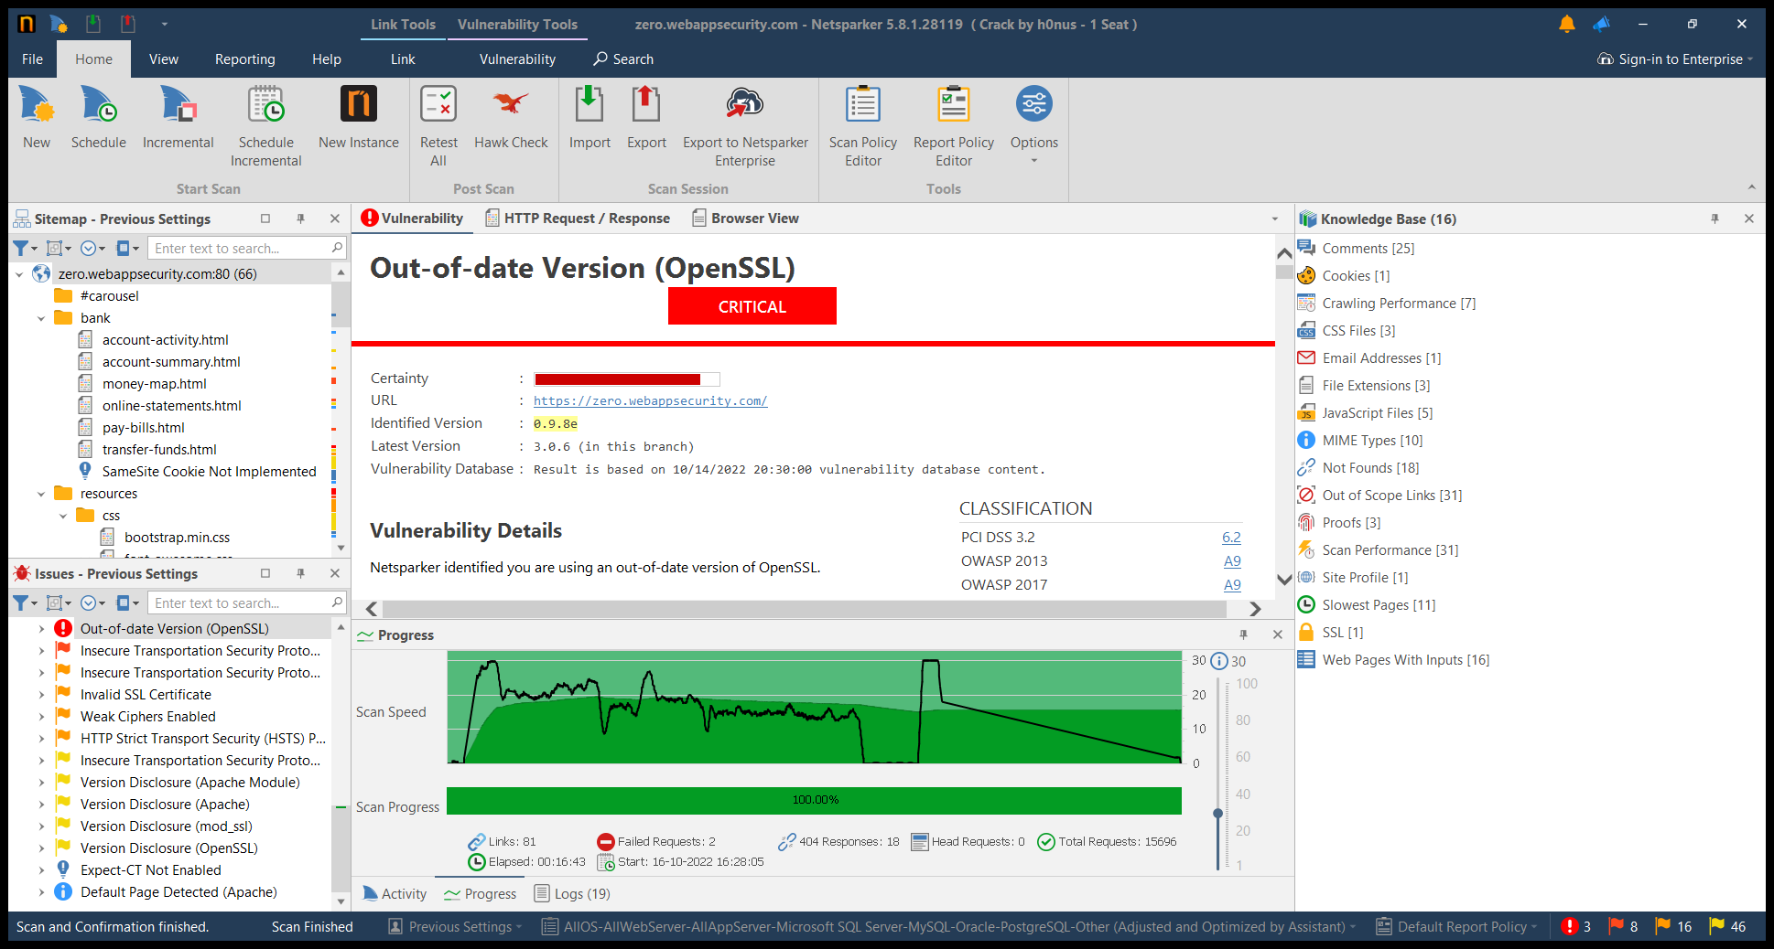
Proof of Concept
Screenshot is attached below

Slide 12
THANK YOU

